Slide 1

28th February –7th MARCH 2025
Introduction to
Topic modelling
Instructor: Xandra Dave Cochran

Slide 2
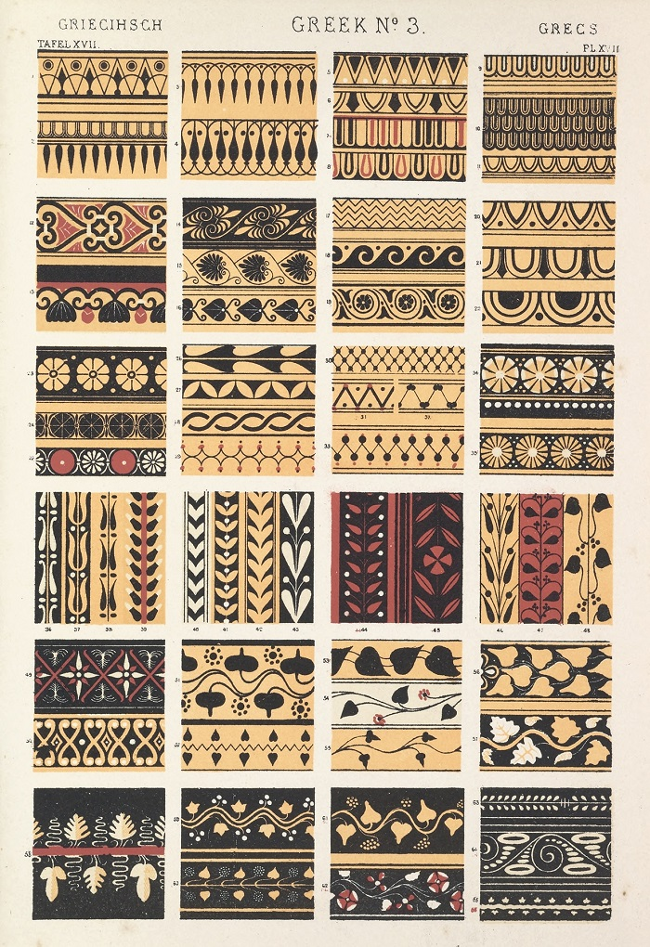



Topic Modelling
Unsupervised Machine Learning
www.cdcs.ed.ac.uk

Slide 3
Topic Modelling
Unsupervised Machine Learning
Identifies clusters of related words in text
www.cdcs.ed.ac.uk

Slide 4
Topic Modelling
Unsupervised Machine Learning
Identifies clusters of related words in text
Does not require predefined categories – good for discovery and exploration of a dataset
www.cdcs.ed.ac.uk

Slide 5
Course Structure
Anticipate about ~7 hours/week
2 hour course meeting, 2-4 Wednesday
1 assignment per week, ~2 hours
Office hours on request
Independent learning, ~2 hours
Teams for introductions, meetings, office hours, questions, files
www.cdcs.ed.ac.uk

Slide 6
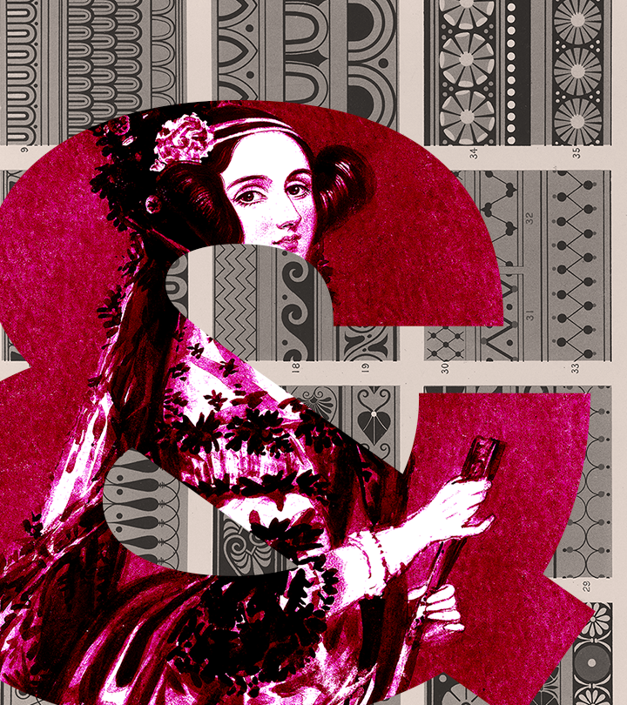
INTRODUCTIONS
What is your previous experience with machine learning?
Why are you interested in topic modelling?
Have you used LLMs before?
Is there a dataset you have in mind to use for topic modelling in future?
www.cdcs.ed.ac.uk

Slide 7

BERTOPIC
Problem: we have more data than we know what to do with! (nice problem to have)
Processing large datasets by hand is very time-consuming
Modern Large Language Models (LLMs) can help – advanced Neural Network models can process large bodies of text to infer meaning, sentiment, topic, etc
BERTopic uses state-of-the-art Transformer models to infer clusters of related words in a dataset, thereby identifying key topics
www.cdcs.ed.ac.uk

Slide 8
A little bit about transformer models
The neural network architecture behind the current AI boom – ChatGPT, Dall-E, etc
Encoder-decoder
Positional encoding
Self-Attention
www.cdcs.ed.ac.uk
Notes:
Building capacity in the Digital Humanities
The Digital Research Infrastructure for the Arts and Humanities (DARIAH) aims to enhance and support digitally-enabled research and teaching across the arts and humanities. DARIAH is a network of people, expertise, information, knowledge, content, methods, tools and technologies from its member countries. It develops, maintains and operates an infrastructure in support of ICT-based research practices and sustains researchers in using them to build, analyse and interpret digital resources. By working with communities of practice, DARIAH brings together individual state-of-the-art digital arts and humanities activities and scales their results to a European level. It preserves, provides access to and disseminates research that stems from these collaborations and ensures that best practices, methodological and technical standards are followed.

Slide 9
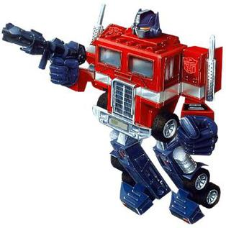
Transformers
www.cdcs.ed.ac.uk
Notes:
Building capacity in the Digital Humanities
The Digital Research Infrastructure for the Arts and Humanities (DARIAH) aims to enhance and support digitally-enabled research and teaching across the arts and humanities. DARIAH is a network of people, expertise, information, knowledge, content, methods, tools and technologies from its member countries. It develops, maintains and operates an infrastructure in support of ICT-based research practices and sustains researchers in using them to build, analyse and interpret digital resources. By working with communities of practice, DARIAH brings together individual state-of-the-art digital arts and humanities activities and scales their results to a European level. It preserves, provides access to and disseminates research that stems from these collaborations and ensures that best practices, methodological and technical standards are followed.

Slide 10
Transformers
Wait, no
www.cdcs.ed.ac.uk
Notes:
Building capacity in the Digital Humanities
The Digital Research Infrastructure for the Arts and Humanities (DARIAH) aims to enhance and support digitally-enabled research and teaching across the arts and humanities. DARIAH is a network of people, expertise, information, knowledge, content, methods, tools and technologies from its member countries. It develops, maintains and operates an infrastructure in support of ICT-based research practices and sustains researchers in using them to build, analyse and interpret digital resources. By working with communities of practice, DARIAH brings together individual state-of-the-art digital arts and humanities activities and scales their results to a European level. It preserves, provides access to and disseminates research that stems from these collaborations and ensures that best practices, methodological and technical standards are followed.

Slide 11
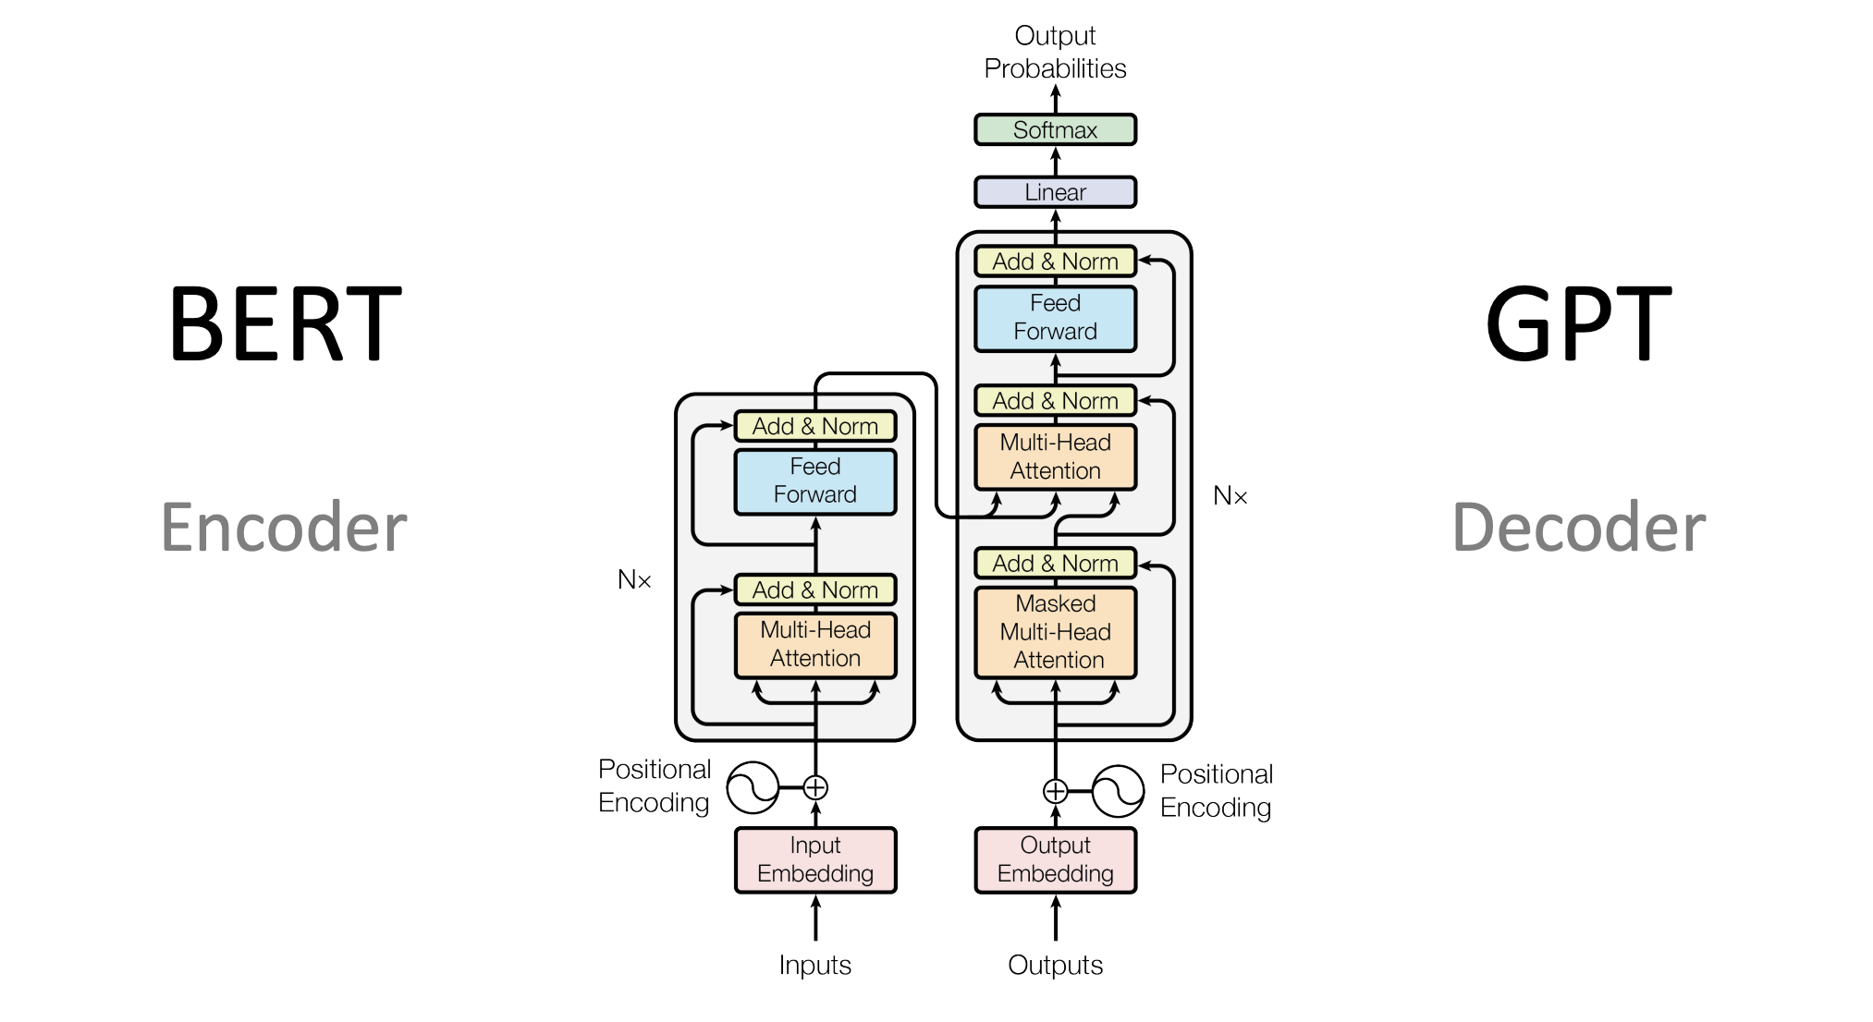
Transformers
www.cdcs.ed.ac.uk
Notes:
Building capacity in the Digital Humanities
The Digital Research Infrastructure for the Arts and Humanities (DARIAH) aims to enhance and support digitally-enabled research and teaching across the arts and humanities. DARIAH is a network of people, expertise, information, knowledge, content, methods, tools and technologies from its member countries. It develops, maintains and operates an infrastructure in support of ICT-based research practices and sustains researchers in using them to build, analyse and interpret digital resources. By working with communities of practice, DARIAH brings together individual state-of-the-art digital arts and humanities activities and scales their results to a European level. It preserves, provides access to and disseminates research that stems from these collaborations and ensures that best practices, methodological and technical standards are followed.

Slide 12

Transformers
Key insight – computers don’t understand text well, they understand large lists of numbers
www.cdcs.ed.ac.uk
Notes:
Building capacity in the Digital Humanities
The Digital Research Infrastructure for the Arts and Humanities (DARIAH) aims to enhance and support digitally-enabled research and teaching across the arts and humanities. DARIAH is a network of people, expertise, information, knowledge, content, methods, tools and technologies from its member countries. It develops, maintains and operates an infrastructure in support of ICT-based research practices and sustains researchers in using them to build, analyse and interpret digital resources. By working with communities of practice, DARIAH brings together individual state-of-the-art digital arts and humanities activities and scales their results to a European level. It preserves, provides access to and disseminates research that stems from these collaborations and ensures that best practices, methodological and technical standards are followed.

Slide 13
Transformers
Key insight – computers don’t understand text well, they understand large lists of numbers
Almost everything in machine learning consists of turning a problem that makes sense to humans (but is very time consuming) into a gnarly mess of linear algebra that makes sense to computers, then converting it back to a human-interpretable form
www.cdcs.ed.ac.uk
Notes:
Building capacity in the Digital Humanities
The Digital Research Infrastructure for the Arts and Humanities (DARIAH) aims to enhance and support digitally-enabled research and teaching across the arts and humanities. DARIAH is a network of people, expertise, information, knowledge, content, methods, tools and technologies from its member countries. It develops, maintains and operates an infrastructure in support of ICT-based research practices and sustains researchers in using them to build, analyse and interpret digital resources. By working with communities of practice, DARIAH brings together individual state-of-the-art digital arts and humanities activities and scales their results to a European level. It preserves, provides access to and disseminates research that stems from these collaborations and ensures that best practices, methodological and technical standards are followed.

Slide 14
Transformers
Key insight – computers don’t understand text well, they understand large lists of numbers
Almost everything in machine learning consists of turning a problem that makes sense to humans (but is very time consuming) into a gnarly mess of linear algebra that makes sense to computers, then converting it back to a human-interpretable form
As such, step 1 is input embedding
www.cdcs.ed.ac.uk
Notes:
Building capacity in the Digital Humanities
The Digital Research Infrastructure for the Arts and Humanities (DARIAH) aims to enhance and support digitally-enabled research and teaching across the arts and humanities. DARIAH is a network of people, expertise, information, knowledge, content, methods, tools and technologies from its member countries. It develops, maintains and operates an infrastructure in support of ICT-based research practices and sustains researchers in using them to build, analyse and interpret digital resources. By working with communities of practice, DARIAH brings together individual state-of-the-art digital arts and humanities activities and scales their results to a European level. It preserves, provides access to and disseminates research that stems from these collaborations and ensures that best practices, methodological and technical standards are followed.

Slide 15
Embeddings
Each word (more accurately, token) is represented as a vector of numbers:
The = [7.3, -6.1, 8.0 ... -0.2, 3.2]
cat = [0.1, 3.2, -0.5 ... 3.7, -1.2]
www.cdcs.ed.ac.uk
Notes:
Building capacity in the Digital Humanities
The Digital Research Infrastructure for the Arts and Humanities (DARIAH) aims to enhance and support digitally-enabled research and teaching across the arts and humanities. DARIAH is a network of people, expertise, information, knowledge, content, methods, tools and technologies from its member countries. It develops, maintains and operates an infrastructure in support of ICT-based research practices and sustains researchers in using them to build, analyse and interpret digital resources. By working with communities of practice, DARIAH brings together individual state-of-the-art digital arts and humanities activities and scales their results to a European level. It preserves, provides access to and disseminates research that stems from these collaborations and ensures that best practices, methodological and technical standards are followed.

Slide 16
Embeddings
Each word (more accurately, token) is represented as a vector of numbers:
The = [7.3, -6.1, 8.0 ... -0.2, 3.2]
cat = [0.1, 3.2, -0.5 ... 3.7, -1.2]
Seems random, but the idea is to train these embeddings to represent meaning as a high-dimensional space
www.cdcs.ed.ac.uk
Notes:
Building capacity in the Digital Humanities
The Digital Research Infrastructure for the Arts and Humanities (DARIAH) aims to enhance and support digitally-enabled research and teaching across the arts and humanities. DARIAH is a network of people, expertise, information, knowledge, content, methods, tools and technologies from its member countries. It develops, maintains and operates an infrastructure in support of ICT-based research practices and sustains researchers in using them to build, analyse and interpret digital resources. By working with communities of practice, DARIAH brings together individual state-of-the-art digital arts and humanities activities and scales their results to a European level. It preserves, provides access to and disseminates research that stems from these collaborations and ensures that best practices, methodological and technical standards are followed.

Slide 17
Embeddings
Each word (more accurately, token) is represented as a vector of numbers:
The = [7.3, -6.1, 8.0 ... -0.2, 3.2]
cat = [0.1, 3.2, -0.5 ... 3.7, -1.2]
Seems random, but the idea is to train these embeddings to represent meaning as a high-dimensional space
This means semantically related words will be closer together than unrelated words – can be measured with cosine distance
www.cdcs.ed.ac.uk
Notes:
Building capacity in the Digital Humanities
The Digital Research Infrastructure for the Arts and Humanities (DARIAH) aims to enhance and support digitally-enabled research and teaching across the arts and humanities. DARIAH is a network of people, expertise, information, knowledge, content, methods, tools and technologies from its member countries. It develops, maintains and operates an infrastructure in support of ICT-based research practices and sustains researchers in using them to build, analyse and interpret digital resources. By working with communities of practice, DARIAH brings together individual state-of-the-art digital arts and humanities activities and scales their results to a European level. It preserves, provides access to and disseminates research that stems from these collaborations and ensures that best practices, methodological and technical standards are followed.

Slide 18
Embeddings
Each word (more accurately, token) is represented as a vector of numbers:
The = [7.3, -6.1, 8.0 ... -0.2, 3.2]
cat = [0.1, 3.2, -0.5 ... 3.7, -1.2]
Seems random, but the idea is to train these embeddings to represent meaning as a high-dimensional space
This means semantically related words will be closer together than unrelated words – can be measured with cosine distance
Displacements in embedding space also have interesting properties, e.g.: (PUPPY – DOG) + CAT ≈ KITTEN
www.cdcs.ed.ac.uk
Notes:
Building capacity in the Digital Humanities
The Digital Research Infrastructure for the Arts and Humanities (DARIAH) aims to enhance and support digitally-enabled research and teaching across the arts and humanities. DARIAH is a network of people, expertise, information, knowledge, content, methods, tools and technologies from its member countries. It develops, maintains and operates an infrastructure in support of ICT-based research practices and sustains researchers in using them to build, analyse and interpret digital resources. By working with communities of practice, DARIAH brings together individual state-of-the-art digital arts and humanities activities and scales their results to a European level. It preserves, provides access to and disseminates research that stems from these collaborations and ensures that best practices, methodological and technical standards are followed.

Slide 19
Token Embedding & Positional Encoding
Each token in a piece of text corresponds to a vector in semantic space
www.cdcs.ed.ac.uk
Notes:
Building capacity in the Digital Humanities
The Digital Research Infrastructure for the Arts and Humanities (DARIAH) aims to enhance and support digitally-enabled research and teaching across the arts and humanities. DARIAH is a network of people, expertise, information, knowledge, content, methods, tools and technologies from its member countries. It develops, maintains and operates an infrastructure in support of ICT-based research practices and sustains researchers in using them to build, analyse and interpret digital resources. By working with communities of practice, DARIAH brings together individual state-of-the-art digital arts and humanities activities and scales their results to a European level. It preserves, provides access to and disseminates research that stems from these collaborations and ensures that best practices, methodological and technical standards are followed.

Slide 20
Token Embedding & Positional Encoding
Each token in a piece of text corresponds to a vector in semantic space
Combine this with another vector that represents the position of the word in the input – usually the output of a periodic function, e.g., a sum of multiple sine and cosine waves
www.cdcs.ed.ac.uk
Notes:
Building capacity in the Digital Humanities
The Digital Research Infrastructure for the Arts and Humanities (DARIAH) aims to enhance and support digitally-enabled research and teaching across the arts and humanities. DARIAH is a network of people, expertise, information, knowledge, content, methods, tools and technologies from its member countries. It develops, maintains and operates an infrastructure in support of ICT-based research practices and sustains researchers in using them to build, analyse and interpret digital resources. By working with communities of practice, DARIAH brings together individual state-of-the-art digital arts and humanities activities and scales their results to a European level. It preserves, provides access to and disseminates research that stems from these collaborations and ensures that best practices, methodological and technical standards are followed.

Slide 21
Self-Attention
Calculate the vector product of each word in the input with all words in the input, sum and normalise the result
www.cdcs.ed.ac.uk
Notes:
Building capacity in the Digital Humanities
The Digital Research Infrastructure for the Arts and Humanities (DARIAH) aims to enhance and support digitally-enabled research and teaching across the arts and humanities. DARIAH is a network of people, expertise, information, knowledge, content, methods, tools and technologies from its member countries. It develops, maintains and operates an infrastructure in support of ICT-based research practices and sustains researchers in using them to build, analyse and interpret digital resources. By working with communities of practice, DARIAH brings together individual state-of-the-art digital arts and humanities activities and scales their results to a European level. It preserves, provides access to and disseminates research that stems from these collaborations and ensures that best practices, methodological and technical standards are followed.

Slide 22
Self-Attention
Calculate the vector product of each word in the input with all words in the input, sum and normalise the result
Insight: words that are related (closer in semantic space) in the input will
be more influential on the result
www.cdcs.ed.ac.uk
Notes:
Building capacity in the Digital Humanities
The Digital Research Infrastructure for the Arts and Humanities (DARIAH) aims to enhance and support digitally-enabled research and teaching across the arts and humanities. DARIAH is a network of people, expertise, information, knowledge, content, methods, tools and technologies from its member countries. It develops, maintains and operates an infrastructure in support of ICT-based research practices and sustains researchers in using them to build, analyse and interpret digital resources. By working with communities of practice, DARIAH brings together individual state-of-the-art digital arts and humanities activities and scales their results to a European level. It preserves, provides access to and disseminates research that stems from these collaborations and ensures that best practices, methodological and technical standards are followed.

Slide 23
Self-Attention
Calculate the vector product of each word in the input with all words in the input, sum and normalise the result
Insight: words that are related (closer in semantic space) in the input will
be more influential on the result
be more likely to be relevant to understanding the context of the focal word (e.g., the presence of ‘river’ disambiguates ‘bank’
www.cdcs.ed.ac.uk
Notes:
Building capacity in the Digital Humanities
The Digital Research Infrastructure for the Arts and Humanities (DARIAH) aims to enhance and support digitally-enabled research and teaching across the arts and humanities. DARIAH is a network of people, expertise, information, knowledge, content, methods, tools and technologies from its member countries. It develops, maintains and operates an infrastructure in support of ICT-based research practices and sustains researchers in using them to build, analyse and interpret digital resources. By working with communities of practice, DARIAH brings together individual state-of-the-art digital arts and humanities activities and scales their results to a European level. It preserves, provides access to and disseminates research that stems from these collaborations and ensures that best practices, methodological and technical standards are followed.

Slide 24
Self-Attention
Calculate the vector product of each word in the input with all words in the input, sum and normalise the result
Insight: words that are related (closer in semantic space) in the input will
be more influential on the result
be more likely to be relevant to understanding the context of the focal word (e.g., the presence of ‘river’ disambiguates ‘bank’
will act to shift the embedding of the original word to its specific meaning in context
www.cdcs.ed.ac.uk
Notes:
Building capacity in the Digital Humanities
The Digital Research Infrastructure for the Arts and Humanities (DARIAH) aims to enhance and support digitally-enabled research and teaching across the arts and humanities. DARIAH is a network of people, expertise, information, knowledge, content, methods, tools and technologies from its member countries. It develops, maintains and operates an infrastructure in support of ICT-based research practices and sustains researchers in using them to build, analyse and interpret digital resources. By working with communities of practice, DARIAH brings together individual state-of-the-art digital arts and humanities activities and scales their results to a European level. It preserves, provides access to and disseminates research that stems from these collaborations and ensures that best practices, methodological and technical standards are followed.

Slide 25
Self-Attention
Calculate the vector product of each word in the input with all words in the input, sum and normalise the result
Insight: words that are related (closer in semantic space) in the input will
be more influential on the result
be more likely to be relevant to understanding the context of the focal word (e.g., the presence of ‘river’ disambiguates ‘bank’
will act to shift the embedding of the original word to its specific meaning in context
www.cdcs.ed.ac.uk
Notes:
Building capacity in the Digital Humanities
The Digital Research Infrastructure for the Arts and Humanities (DARIAH) aims to enhance and support digitally-enabled research and teaching across the arts and humanities. DARIAH is a network of people, expertise, information, knowledge, content, methods, tools and technologies from its member countries. It develops, maintains and operates an infrastructure in support of ICT-based research practices and sustains researchers in using them to build, analyse and interpret digital resources. By working with communities of practice, DARIAH brings together individual state-of-the-art digital arts and humanities activities and scales their results to a European level. It preserves, provides access to and disseminates research that stems from these collaborations and ensures that best practices, methodological and technical standards are followed.

Slide 26
Add & Norm
The output of attention is added to the original embedding vectors, and normalised so each vector sums to 1.0
www.cdcs.ed.ac.uk
Notes:
Building capacity in the Digital Humanities
The Digital Research Infrastructure for the Arts and Humanities (DARIAH) aims to enhance and support digitally-enabled research and teaching across the arts and humanities. DARIAH is a network of people, expertise, information, knowledge, content, methods, tools and technologies from its member countries. It develops, maintains and operates an infrastructure in support of ICT-based research practices and sustains researchers in using them to build, analyse and interpret digital resources. By working with communities of practice, DARIAH brings together individual state-of-the-art digital arts and humanities activities and scales their results to a European level. It preserves, provides access to and disseminates research that stems from these collaborations and ensures that best practices, methodological and technical standards are followed.

Slide 27
Add & Norm
The output of attention is added to the original embedding vectors, and normalised so each vector sums to 1.0
The result is a reweighted version of the embedding which accounts for context
www.cdcs.ed.ac.uk
Notes:
Building capacity in the Digital Humanities
The Digital Research Infrastructure for the Arts and Humanities (DARIAH) aims to enhance and support digitally-enabled research and teaching across the arts and humanities. DARIAH is a network of people, expertise, information, knowledge, content, methods, tools and technologies from its member countries. It develops, maintains and operates an infrastructure in support of ICT-based research practices and sustains researchers in using them to build, analyse and interpret digital resources. By working with communities of practice, DARIAH brings together individual state-of-the-art digital arts and humanities activities and scales their results to a European level. It preserves, provides access to and disseminates research that stems from these collaborations and ensures that best practices, methodological and technical standards are followed.

Slide 28
Feed Forward
Feed the result through a simple feed forward neural network
Add to original values and normalise again
Repeat
www.cdcs.ed.ac.uk
Notes:
Building capacity in the Digital Humanities
The Digital Research Infrastructure for the Arts and Humanities (DARIAH) aims to enhance and support digitally-enabled research and teaching across the arts and humanities. DARIAH is a network of people, expertise, information, knowledge, content, methods, tools and technologies from its member countries. It develops, maintains and operates an infrastructure in support of ICT-based research practices and sustains researchers in using them to build, analyse and interpret digital resources. By working with communities of practice, DARIAH brings together individual state-of-the-art digital arts and humanities activities and scales their results to a European level. It preserves, provides access to and disseminates research that stems from these collaborations and ensures that best practices, methodological and technical standards are followed.

Slide 29
Feed Forward
Feed the result through a simple feed forward neural network
Add to original values and normalise again
Repeat
www.cdcs.ed.ac.uk
Notes:
Building capacity in the Digital Humanities
The Digital Research Infrastructure for the Arts and Humanities (DARIAH) aims to enhance and support digitally-enabled research and teaching across the arts and humanities. DARIAH is a network of people, expertise, information, knowledge, content, methods, tools and technologies from its member countries. It develops, maintains and operates an infrastructure in support of ICT-based research practices and sustains researchers in using them to build, analyse and interpret digital resources. By working with communities of practice, DARIAH brings together individual state-of-the-art digital arts and humanities activities and scales their results to a European level. It preserves, provides access to and disseminates research that stems from these collaborations and ensures that best practices, methodological and technical standards are followed.

Slide 30

BERTopic
This can be used to solve next-word problems (chat GPT), missing-word problems, and calculate embeddings for larger blocks of text (BERT)
www.cdcs.ed.ac.uk
Notes:
Building capacity in the Digital Humanities
The Digital Research Infrastructure for the Arts and Humanities (DARIAH) aims to enhance and support digitally-enabled research and teaching across the arts and humanities. DARIAH is a network of people, expertise, information, knowledge, content, methods, tools and technologies from its member countries. It develops, maintains and operates an infrastructure in support of ICT-based research practices and sustains researchers in using them to build, analyse and interpret digital resources. By working with communities of practice, DARIAH brings together individual state-of-the-art digital arts and humanities activities and scales their results to a European level. It preserves, provides access to and disseminates research that stems from these collaborations and ensures that best practices, methodological and technical standards are followed.

Slide 31
BERTopic
This can be used to solve next-word problems (chat GPT), missing-word problems, and calculate embeddings for larger blocks of text (BERT)
In BERTopic, this is combined with a custom Term Frequency-Inverse Document Frequency model to induce clusters of related words, and this discover topics in a dataset
www.cdcs.ed.ac.uk
Notes:
Building capacity in the Digital Humanities
The Digital Research Infrastructure for the Arts and Humanities (DARIAH) aims to enhance and support digitally-enabled research and teaching across the arts and humanities. DARIAH is a network of people, expertise, information, knowledge, content, methods, tools and technologies from its member countries. It develops, maintains and operates an infrastructure in support of ICT-based research practices and sustains researchers in using them to build, analyse and interpret digital resources. By working with communities of practice, DARIAH brings together individual state-of-the-art digital arts and humanities activities and scales their results to a European level. It preserves, provides access to and disseminates research that stems from these collaborations and ensures that best practices, methodological and technical standards are followed.

Slide 32
DEMO 1

Slide 33
Attributes
There are a number of attributes that you can access after having trained your BERTopic model:
Attribute | Description
topics_ | The topics that are generated for each document after training or updating the topic model.
probabilities_ | The probabilities that are generated for each document if HDBSCAN is used.
topic_sizes_ | The size of each topic
topic_mapper_ | A class for tracking topics and their mappings anytime they are merged/reduced.
topic_representations_ | The top n terms per topic and their respective c-TF-IDF values.
c_tf_idf_ | The topic-term matrix as calculated through c-TF-IDF.
topic_labels_ | The default labels for each topic.
custom_labels_ | Custom labels for each topic as generated through set_topic_labels.
topic_embeddings_ | The embeddings for each topic if embedding_model was used.
representative_docs_ | The representative documents for each topic if HDBSCAN is used.
www.cdcs.ed.ac.uk

Slide 34
We can visualise
Topics
Topic Probabilities
Topic Hierarchies
Terms
Topic Similarity
www.cdcs.ed.ac.uk
Notes:
Building capacity in the Digital Humanities
The Digital Research Infrastructure for the Arts and Humanities (DARIAH) aims to enhance and support digitally-enabled research and teaching across the arts and humanities. DARIAH is a network of people, expertise, information, knowledge, content, methods, tools and technologies from its member countries. It develops, maintains and operates an infrastructure in support of ICT-based research practices and sustains researchers in using them to build, analyse and interpret digital resources. By working with communities of practice, DARIAH brings together individual state-of-the-art digital arts and humanities activities and scales their results to a European level. It preserves, provides access to and disseminates research that stems from these collaborations and ensures that best practices, methodological and technical standards are followed.

Slide 35
DEMO 2

Slide 36
We can visualise
Topics
Topic Probabilities
Topic Hierarchies
Terms
Topic Similarity
Also, we can
Search topics
Reduce topics
www.cdcs.ed.ac.uk
Notes:
Building capacity in the Digital Humanities
The Digital Research Infrastructure for the Arts and Humanities (DARIAH) aims to enhance and support digitally-enabled research and teaching across the arts and humanities. DARIAH is a network of people, expertise, information, knowledge, content, methods, tools and technologies from its member countries. It develops, maintains and operates an infrastructure in support of ICT-based research practices and sustains researchers in using them to build, analyse and interpret digital resources. By working with communities of practice, DARIAH brings together individual state-of-the-art digital arts and humanities activities and scales their results to a European level. It preserves, provides access to and disseminates research that stems from these collaborations and ensures that best practices, methodological and technical standards are followed.

Slide 37
DEMO 3

Slide 38
Thanks Everyone!
Next class: Friday 7th March, 10-12AM
Please message me on Teams for office hours!

